Slide 1
Java 기초
(AWT 컴포넌트와 이벤트 처리 프로그래밍)
2009. 11. 13
Choi, Namseok
http://sugi.pe.kr

Slide 2
Last
자바의 객체와 클래스

Slide 3
Contents
AWT 소개
AWT 컨테이너 컴포넌트
AWT 비주얼 컴포넌트들
컴포넌트의 배치와 레이아웃

Slide 4
AWT 소개
AWT 개념과 컴포넌트 관련 API들
AWT 컴포넌트 소개

Slide 5
AWT 개념과 컴포넌트 관련 API들
UI는 사용자가 컴퓨터와 대화 가능하도록 제공하는 방법
CUI는 키보드를 통하여 문자 형태 제공
GUI는 단추, 아이콘등 그래픽 도구 제공
AWT는 GUI 구현 컴포넌트 모음

Slide 6
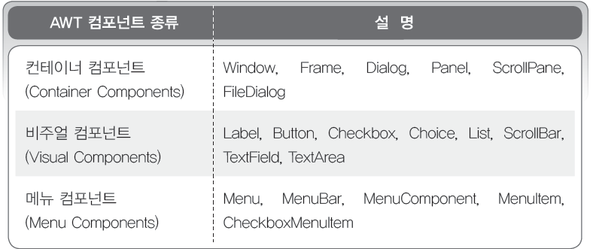
AWT 컴포넌트 소개
AWT 컴포넌트의 분류

Slide 7
AWT 컨테이너 컴포넌트
AWT 컨테이너 컴포넌트 종류
  Frame
  Panel

Slide 8
AWT 컨테이너 컴포넌트 종류
컨테이너 컴포넌트들의 상속 관계

Slide 9
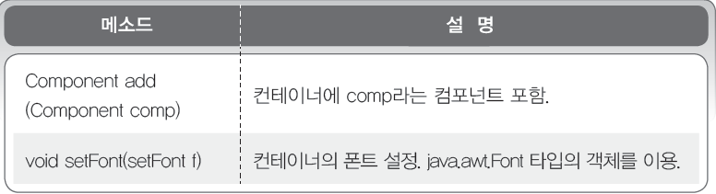
AWT 컨테이너 컴포넌트 종류
컨테이너 컴포넌트들의 메소드

Slide 10
Frame
대부분의 UI 프로그램에서 사용
타이틀바, 테두리, 메뉴바, 크기 조절 가능
생성된 후 setSize() 메소드나 setBounds() 메소드 호출하여 크기 지정 가능
생성된 후 setVisible() 메소드 호출하여 화면 보이게 함

Slide 11
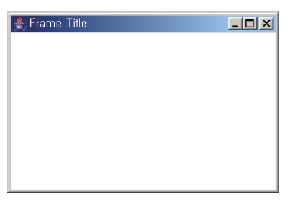
Frame
주요 생성자
Frame 객체 생성과 결과

Slide 12

Frame 실습
실습 Exam_01
기본적인 Frame 제작하기
결과화면

Slide 13
Frame 실습
Exam_01.java
import java.awt.*;
public class Exam_01 {
  public static void main(String[] ar) {
    Frame f = new Frame();
    Frame f1 = new Frame();
  }
}

Slide 14


Frame 실습
import java.awt.*;
public class Exam_01 {
  public static void main(String[] ar) {
    Frame f = new Frame();
    Frame f1 = new Frame();
    f.setVisible(true);
    f1.setVisible(true);
  }
}

Slide 15
Frame 실습
기본 사이즈 설정
f.setSize(300, 200);
f1.setSize(400, 400);
f.setLocation(200, 200);
f1.setLocation(300, 300);
f.setResizable(false);
f1.setResizable(false);

Slide 16
Frame 실습
화면 중간에 배치
Dimension screen = Toolkit.getDefaultToolkit().getScreenSize();
Dimension f_size = f.getSize();
Dimension f1_size = f1.getSize();
int xpos = (int)(screen.getWidth() / 2 - f_size.getWidth() / 2);
int ypos = (int)(screen.getHeight() / 2 - f_size.getHeight() / 2);
f.setLocation(xpos, ypos);
int xpos1 = (int)(screen.getWidth() / 2 - f1_size.getWidth() / 2);
int ypos1 = (int)(screen.getHeight() / 2 - f1_size.getHeight() / 2);
f1.setLocation(xpos1, ypos1);

Slide 17
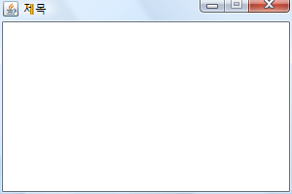
Frame 실습
GUI 기본 코드
import java.awt.*;
class Exam_02_Sub extends Frame{
  public Exam_02_Sub(String title) {
    super(title);
    super.setSize(300, 200);
    Dimension screen = Toolkit.getDefaultToolkit().getScreenSize();
    Dimension frm = super.getSize();
    int xpos = (int)(screen.getWidth() / 2 - frm.getWidth() / 2);
    int ypos = (int)(screen.getHeight() / 2 - frm.getHeight() / 2);
    super.setLocation(xpos, ypos);
    super.setResizable(false);
    super.setVisible(true);
  }
}
public class Exam_02 {
  public static void main(String[] ar) {
  Exam_02_Sub ex = new Exam_02_Sub("제목");
  }
}

Slide 18
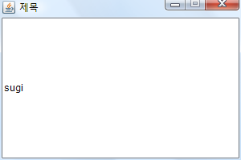
Frame 실습
Label 사용
class Exam_03_Sub extends Frame{
  private Label lb = new Label("sugi");
  public Exam_03_Sub(String title) {
    super(title);
    this.init();
    super.setSize(300, 200);
    Dimension screen = Toolkit.getDefaultToolkit().getScreenSize();
    Dimension frm = super.getSize();
    int xpos = (int)(screen.getWidth() / 2 - frm.getWidth() / 2);
    int ypos = (int)(screen.getHeight() / 2 - frm.getHeight() / 2);
    super.setLocation(xpos, ypos);
    super.setResizable(false);
    super.setVisible(true);
  }
  public void init() {// 화면 초기화 작업
    this.add(lb);
  }
}

Slide 19
Layout Manager
FlowLayout Manager
GridLayout Manager
BorderLayout Manager
CardLayout Manager
GridBagLayout Manager

Slide 20
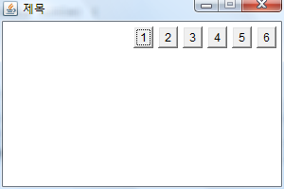
Layout 실습 - FlowLayout
Button 컴포넌트 사용
class Exam_04_Sub extends Frame{
  private Button bt1 = new Button("1");
  private Button bt2 = new Button("2");
  private Button bt3 = new Button("3");
  private Button bt4 = new Button("4");
  private Button bt5 = new Button("5");
  private Button bt6 = new Button("6");
  private FlowLayout fl = new FlowLayout(FlowLayout.RIGHT);
  public Exam_04_Sub(String title) {
    super(title);
    this.init();
    super.setSize(300, 200);
    Dimension screen = Toolkit.getDefaultToolkit().getScreenSize();
    Dimension frm = super.getSize();

Slide 21
Layout 실습
    int xpos = (int)(screen.getWidth() / 2 - frm.getWidth() / 2);
    int ypos = (int)(screen.getHeight() / 2 - frm.getHeight() / 2);
    super.setLocation(xpos, ypos);
    super.setResizable(false);
    super.setVisible(true);
  }
  public void init() {
    this.setLayout(fl);
    this.add(bt1);
    this.add(bt2);
    this.add(bt3);
    this.add(bt4);
    this.add(bt5);
    this.add(bt6);
  }
}

Slide 22
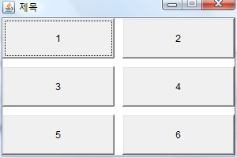
Layout 실습 - GridLayout
class Exam_05_Sub extends Frame{
  private Button bt1 = new Button("1");
  private Button bt2 = new Button("2");
  private Button bt3 = new Button("3");
  private Button bt4 = new Button("4");
  private Button bt5 = new Button("5");
  private Button bt6 = new Button("6");
  private GridLayout fl = new GridLayout(3, 2, 10, 10);
  public Exam_05_Sub(String title) {
    super(title);
    this.init();
    super.setSize(300, 200);
    Dimension screen = Toolkit.getDefaultToolkit().getScreenSize();
    Dimension frm = super.getSize();

Slide 23
Layout 실습 - GridLayout
    int xpos = (int)(screen.getWidth() / 2 - frm.getWidth() / 2);
    int ypos = (int)(screen.getHeight() / 2 - frm.getHeight() / 2);
    super.setLocation(xpos, ypos);
    super.setResizable(false);
    super.setVisible(true);
  }
  public void init() {
    this.setLayout(fl);
    this.add(bt1);
    this.add(bt2);
    this.add(bt3);
    this.add(bt4);
    this.add(bt5);
    this.add(bt6);
  }
}

Slide 24
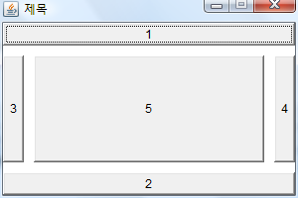
Layout 실습 - BorderLayout
class Exam_06_Sub extends Frame{
  private Button bt1 = new Button("1");
  private Button bt2 = new Button("2");
  private Button bt3 = new Button("3");
  private Button bt4 = new Button("4");
  private Button bt5 = new Button("5");
  private BorderLayout fl = new BorderLayout(10, 10);
  public Exam_06_Sub(String title) {
    super(title);
    this.init();
    super.setSize(300, 200);
    Dimension screen = Toolkit.getDefaultToolkit().getScreenSize();
    Dimension frm = super.getSize();

Slide 25
Layout 실습 - BorderLayout
    int xpos = (int)(screen.getWidth() / 2 - frm.getWidth() / 2);
    int ypos = (int)(screen.getHeight() / 2 - frm.getHeight() / 2);
    super.setLocation(xpos, ypos);
    super.setResizable(false);
    super.setVisible(true);
  }
  public void init() {
    this.setLayout(fl);
    this.add("North", bt1);
    this.add("South", bt2);
    this.add("West", bt3);
    this.add("East", bt4);
    this.add("Center", bt5);
  }
}

Slide 26
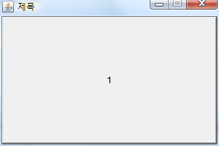
Layout 실습 - CardLayout
class Exam_07_Sub extends Frame{
  private Button bt1 = new Button("1");
  private Button bt2 = new Button("2");
  private Button bt3 = new Button("3");
  private CardLayout fl = new CardLayout();
  public Exam_07_Sub(String title) {
    super(title);
    this.init();
    super.setSize(300, 200);
    Dimension screen = Toolkit.getDefaultToolkit().getScreenSize();
    Dimension frm = super.getSize();
    int xpos = (int)(screen.getWidth() / 2 - frm.getWidth() / 2);
    int ypos = (int)(screen.getHeight() / 2 - frm.getHeight() / 2);

Slide 27
Layout 실습 - CardLayout
    super.setLocation(xpos, ypos);
    super.setResizable(false);
    super.setVisible(true);
  }
  public void init() {
    this.setLayout(fl);
    this.add("aa", bt1);
    this.add("bb", bt2);
    this.add("cc", bt3);
  }
}

Slide 28
Layout 실습 - CardLayout
try {
Thread.sleep(2000);
}catch(InterruptedException e) {}
fl.show(this, "bb");
try {
Thread.sleep(2000);
}catch(InterruptedException e) {}
fl.show(this, "cc");
try {
Thread.sleep(2000);
}catch(InterruptedException e) {}
fl.show(this, "aa");

Slide 29
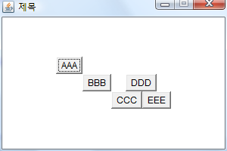
Layout 실습 - CardLayout
class Exam_08_Sub extends Frame{
  private Button bt1 = new Button("AAA");
  private Button bt2 = new Button("BBB");
  private Button bt3 = new Button("CCC");
  private Button bt4 = new Button("DDD");
  private Button bt5 = new Button("EEE");
  private Button bt6 = new Button("FFF");
  private Button bt7 = new Button("GGG");
  private GridBagLayout fl = new GridBagLayout();
  private GridBagConstraints gc = new GridBagConstraints();
  public Exam_08_Sub(String title) {
    super(title);
    this.init();
    super.setSize(300, 200);
    Dimension screen = Toolkit.getDefaultToolkit().getScreenSize();
    Dimension frm = super.getSize();

Slide 30
Layout 실습 - CardLayout
    int xpos = (int)(screen.getWidth() / 2 - frm.getWidth() / 2);
    int ypos = (int)(screen.getHeight() / 2 - frm.getHeight() / 2);
    super.setLocation(xpos, ypos);
    super.setResizable(false);
    super.setVisible(true);
  }
  public void init() {
    this.setLayout(fl);
    gc.gridx = 0;
    gc.gridy = 0;
    fl.setConstraints(bt1, gc);
    this.add(bt1);
    gc.gridx = 1;
    gc.gridy = 1;
    fl.setConstraints(bt2, gc);
    this.add(bt2);

Slide 31
Layout 실습 - CardLayout
    gc.gridx = 2;
    gc.gridy = 2;
    fl.setConstraints(bt3, gc);
    this.add(bt3);
    gc.gridx = 3;
    gc.gridy = 2;
    fl.setConstraints(bt5, gc);
    this.add(bt5);
    gc.gridx = 2;
    gc.gridy = 1;
    gc.gridwidth = 2;
    fl.setConstraints(bt4, gc);
    this.add(bt4);
  }
}

Slide 32
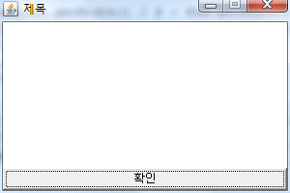
Layout 실습
class Exam_09_Sub extends Frame{
  private Button bt = new Button("확인");
  private BorderLayout bl = new BorderLayout();
  public Exam_09_Sub(String title) {
    super(title);
    this.init();
    super.setSize(300, 200);
    Dimension screen = Toolkit.getDefaultToolkit().getScreenSize();
    Dimension frm = super.getSize();
    int xpos = (int)(screen.getWidth() / 2 - frm.getWidth() / 2);
    int ypos = (int)(screen.getHeight() / 2 - frm.getHeight() / 2);

Slide 33
Layout 실습
    super.setLocation(xpos, ypos);
    super.setResizable(false);
    super.setVisible(true);
  }
  public void init() {
    this.setLayout(bl);
    this.add("South", bt);
  }
}

Slide 34
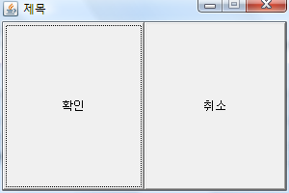
Layout 실습
class Exam_10_Sub extends Frame{
  private Button bt = new Button("확인");
  private Button bt1 = new Button("취소");
  private GridLayout gl = new GridLayout(1, 2);
  public Exam_10_Sub(String title) {
    super(title);
    this.init();
    super.setSize(300, 200);
    Dimension screen = Toolkit.getDefaultToolkit().getScreenSize();
    Dimension frm = super.getSize();

Slide 35
Layout 실습
  int xpos = (int)(screen.getWidth() / 2 - frm.getWidth() / 2);
  int ypos = (int)(screen.getHeight() / 2 - frm.getHeight() / 2);
  super.setLocation(xpos, ypos);
  super.setResizable(false);
  super.setVisible(true);
  }
  public void init() {
    this.setLayout(gl);
    this.add(bt);
    this.add(bt1);
  }
}

Slide 36
Panel
컴포넌트 추가 가능한 중간 단계의 가상의 방 역할
컴포넌트들을 그룹지어 배치시 사용
생성자
Panel 객체 생성과 결과

Slide 37
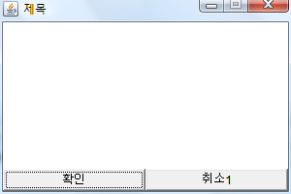
Panel 실습
class Exam_11_Sub extends Frame{
  private Button yes_bt = new Button("확인");
  private Button no1_bt = new Button("취소1");
  private Panel p = new Panel();
  private BorderLayout bl = new BorderLayout();
  private GridLayout gl = new GridLayout(1, 2);
  public Exam_11_Sub(String title) {
    super(title);
    this.init();
    super.setSize(300, 200);
    Dimension screen = Toolkit.getDefaultToolkit().getScreenSize();
    Dimension frm = super.getSize();

Slide 38
Panel 실습
    int xpos = (int)(screen.getWidth() / 2 - frm.getWidth() / 2);
    int ypos = (int)(screen.getHeight() / 2 - frm.getHeight() / 2);
    super.setLocation(xpos, ypos);
    super.setResizable(false);
    super.setVisible(true);
  }
  public void init() {
    this.setLayout(bl);
    p.setLayout(gl);
    p.add(yes_bt);
    p.add(no1_bt);
    this.add("South", p);
  }
}

Slide 39
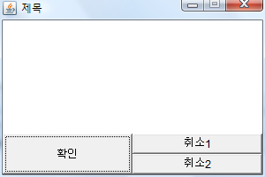
Panel 실습

