Slide 1
Java 기초
(AWT 컴포넌트와 이벤트 처리 프로그래밍2)
2009. 11. 20
Choi, Namseok
http://sugi.pe.kr

Slide 2
Last
AWT 소개
AWT 컨테이너 컴포넌트
AWT 비주얼 컴포넌트들
컴포넌트의 배치와 레이아웃

Slide 3
Contents
Panel 클래스
주변 클래스들
AWT 관련 컴포넌트

Slide 4
Panel 클래스
Panel 클래스 : Layout Manager를 적용하기 위한 영역
Panel 클래스에는 또 다른 Panel 클래스가 추가 될 수 있다.
Panel 클래스는 Layout Manager에 의해 영역을 분할할 수 있다.

Slide 5
Panel
컴포넌트 추가 가능한 중간 단계의 가상의 방 역할
컴포넌트들을 그룹지어 배치시 사용
생성자
Panel 객체 생성과 결과

Slide 6
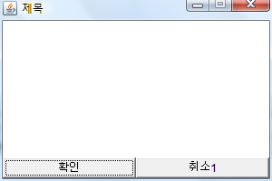
Panel 실습
class Exam_01_Sub extends Frame{
  private Button yes_bt = new Button("확인");
  private Button no1_bt = new Button("취소1");
  private Panel p = new Panel();
  private BorderLayout bl = new BorderLayout();
  private GridLayout gl = new GridLayout(1, 2);
  public Exam_01_Sub(String title) {
    super(title);
    this.init();
    super.setSize(300, 200);
    Dimension screen = Toolkit.getDefaultToolkit().getScreenSize();
    Dimension frm = super.getSize();

Slide 7
Panel 실습
    int xpos = (int)(screen.getWidth() / 2 - frm.getWidth() / 2);
    int ypos = (int)(screen.getHeight() / 2 - frm.getHeight() / 2);
    super.setLocation(xpos, ypos);
    super.setResizable(false);
    super.setVisible(true);
  }
  public void init() {
    this.setLayout(bl);
    p.setLayout(gl);
    p.add(yes_bt);
    p.add(no1_bt);
    this.add("South", p);
  }
}

Slide 8
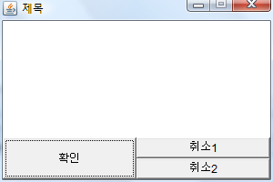
Panel 실습

Slide 9
주변 클래스들
java.awt.Color 클래스
java.awt.Cursor 클래스
java.awt.Dimension 클래스
java.awt.Font 클래스

Slide 10
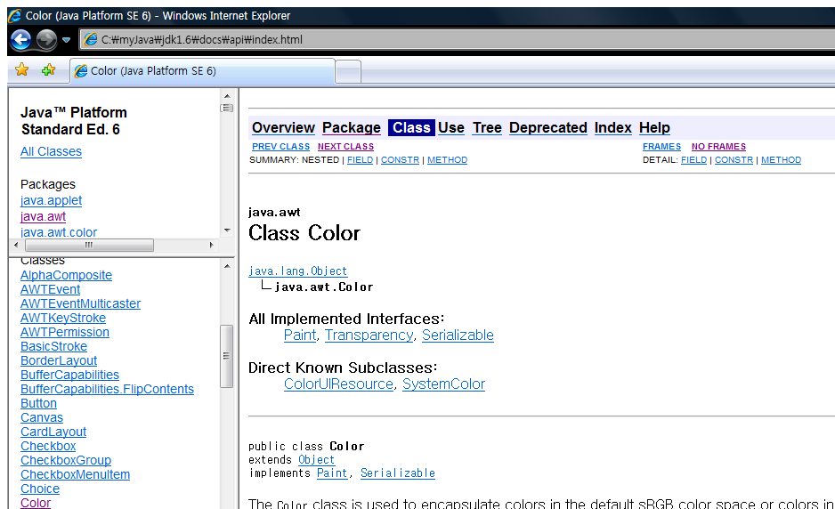
java.awt.Color 클래스

Slide 11
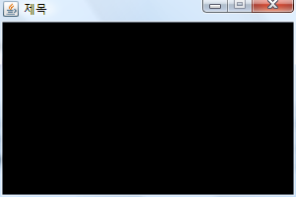
java.awt.Color 클래스 실습
class Exam_02_Sub extends Frame{
  public Exam_02_Sub(String title) {
    super(title);
    this.init();
    super.setSize(300, 200);
    Dimension screen = Toolkit.getDefaultToolkit().getScreenSize();
    Dimension frm = super.getSize();
    int xpos = (int)(screen.getWidth() / 2 - frm.getWidth() / 2);
    int ypos = (int)(screen.getHeight() / 2 - frm.getHeight() / 2);
    super.setLocation(xpos, ypos);
    super.setResizable(false);
    super.setVisible(true);
  }

Slide 12
java.awt.Color 클래스 실습
Color 변경
  public void init() {
    this.setBackground(Color.BLACK);
  }
}
  private Color cc = new Color(58, 110,165);
  public void init() {
    this.setBackground(cc);
  }

Slide 13
java.awt.Color 클래스 실습
Button Color 변경
  private Color cc = new Color(58, 110,165);
  private Button bt = new Button(“확인”);
  private GridBagLayout gbl = new GridBagLayout();
  public void init() {
    this.setBackground(cc);
    this.setLayout(gbl);
    bt.setBackground(Color.BALCK);
    bt.setForeground(Color.WHITE);
    this.add(bt);
  }

Slide 14
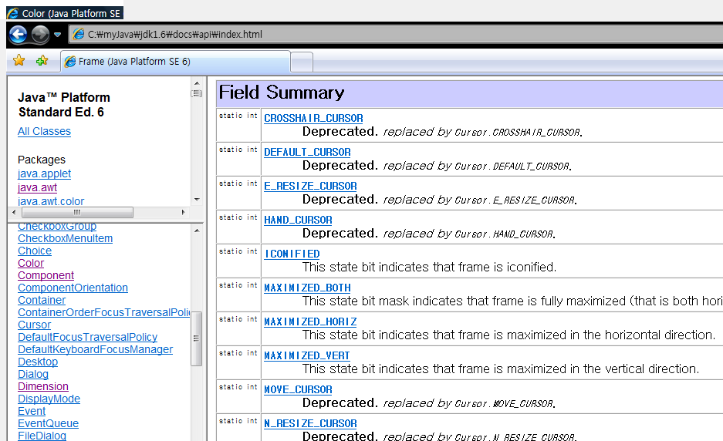
java.awt.Cursor 클래스

Slide 15
java.awt.Cursor 클래스 실습
class Exam_03_Sub extends Frame{
  public Exam_03_Sub(String title) {
    super(title);
    this.init();
    super.setSize(300, 200);
    Dimension screen = Toolkit.getDefaultToolkit().getScreenSize();
    Dimension frm = super.getSize();
    int xpos = (int)(screen.getWidth() / 2 - frm.getWidth() / 2);
    int ypos = (int)(screen.getHeight() / 2 - frm.getHeight() / 2);
    super.setLocation(xpos, ypos);
    super.setResizable(false);
    super.setVisible(true);
  }

Slide 16
java.awt.Cursor 클래스 실습
클래스 사용
  public void init() {
    this.setCursor (Cursor.HAND_CURSOR);
  }
}
  private Cursor cur = new Cursor(Cursor.HAND_CURSOR);
  public void init() {
    this.setCursor (cur);
  }

Slide 17
java.awt.Cursor 클래스 실습
  private Cursor cur1 = new Cursor(HAND_CURSOR);
  private Cursor cur2 = new Cursor(TEXT_CURSOR);
  private Button bt = new Button(“확인”);
  private GridBagLayout gbl = new GridBagLayout();
  public void init() {
    this.setCursor (cur2);
    this.setLayout(gbl);
    bt.setCursor(cur1);
    this.add(bt);
  }

Slide 18
java.awt.Dimension 클래스
class Exam_04_Sub extends Frame{
  public Exam_04_Sub(String title) {
    super(title);
    this.init();
    super.setSize(300, 200);
    Dimension screen = Toolkit.getDefaultToolkit().getScreenSize();
    Dimension frm = super.getSize();
    Dimension a = new Dimension(100, 200);
    System.out.println("screen.width = " + screen.getWidth());
    System.out.println("screen.height = " + screen.getHeight());
    System.out.println("frm.width = " + frm.getWidth());
    System.out.println("frm.height = " + frm.getHeight());

Slide 19
java.awt.Dimension 클래스
    System.out.println("a.width = " + a.getWidth());
    System.out.println("a.height = " + a.getHeight());
    int xpos = (int)(screen.getWidth() / 2 - frm.getWidth() / 2);
    int ypos = (int)(screen.getHeight() / 2 - frm.getHeight() / 2);
    super.setLocation(xpos, ypos);
    super.setResizable(false);
    super.setVisible(true);
  }

Slide 20
java.awt.Font 클래스
class Exam_04_Sub extends Frame{
  private Button bt = new Button("확인");
  private GridBagLayout gbl = new GridBagLayout();
  private Font font = new Font("휴먼옛체", Font.BOLD, 20);
  public Exam_04_Sub(String title) {
    super(title);
    this.init();
    super.setSize(300, 200);
    Dimension screen = Toolkit.getDefaultToolkit().getScreenSize();
    Dimension frm = super.getSize();

Slide 21
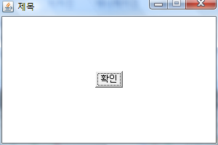
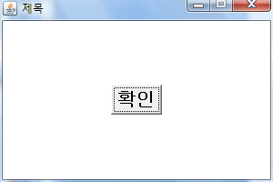
java.awt.Font 클래스
    int xpos = (int)(screen.getWidth() / 2 - frm.getWidth() / 2);
    int ypos = (int)(screen.getHeight() / 2 - frm.getHeight() / 2);
    super.setLocation(xpos, ypos);
    super.setResizable(false);
    super.setVisible(true);
  }
  public void init() {
    this.setLayout(gbl);
    bt.setFont(font);
    this.add(bt);
  }
}

Slide 22
AWT 관련 컴포넌트
Java.awt.Label 클래스
Java.awt.Button 클래스
Java.awt.Checkbox 클래스
Java.awt.CheckboxGroup 클래스
Java.awt Choice 클래스
Java.awt.List 클래스
Java.awt.TextField & TextArea 클래스
Java.awt.Dialog & FileDialog 클래스
Java.awt.Menu, MenuItem 클래스

Slide 23
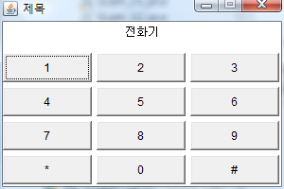
Java.awt.Label / Button 클래스

Slide 24
Java.awt.Label / Button 클래스
class Exam_05_Sub extends Frame{
  private Label lb = new Label("전화기", Label.CENTER);
  private Button[] bt = new Button[12];
  private String[] str = new String[] {"*", "0", "#"};
  private BorderLayout bl = new BorderLayout(10, 10);
  private Panel p = new Panel();
  private GridLayout gl = new GridLayout(4, 3, 5, 5);
  public Exam_05_Sub(String title) {
    super(title);
    this.init();
    super.setSize(300, 200);
    Dimension screen = Toolkit.getDefaultToolkit().getScreenSize();
    Dimension frm = super.getSize();

Slide 25
Java.awt.Label / Button 클래스
    int xpos = (int)(screen.getWidth() / 2 - frm.getWidth() / 2);
    int ypos = (int)(screen.getHeight() / 2 - frm.getHeight() / 2);
    super.setLocation(xpos, ypos);
    super.setResizable(false);
    super.setVisible(true);
  }

Slide 26
Java.awt.Label / Button 클래스
  public void init() {
    this.setLayout(bl);
    this.add("North", lb);
    p.setLayout(gl);
    for(int i = 0; i < bt.length; i++) {
      bt[i] = new Button(String.valueOf(i + 1));
      if(i >= 9) {
        bt[i] = new Button(str[i-9]);
      }
      p.add(bt[i]);
    }
    this.add("Center", p);
  }
}

Slide 27
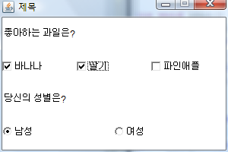
Java.awt.Checkbox / CheckboxGroup클래스

Slide 28
Java.awt.Checkbox / CheckboxGroup클래스
class Exam_06_Sub extends Frame{
  private Label fri_lb = new Label("좋아하는 과일은?");
  private Checkbox a_cb = new Checkbox("바나나");
  private Checkbox b_cb = new Checkbox("딸기");
  private Checkbox c_cb = new Checkbox("파인애플");
  private Label sex_lb = new Label("당신의 성별은?");
  private CheckboxGroup cg = new CheckboxGroup();
  private Checkbox man_cb = new Checkbox("남성", cg, true);
  private Checkbox woman_cb = new Checkbox("여성", cg, false);
  private GridLayout gl = new GridLayout(4, 1);
  private Panel p = new Panel();
  private GridLayout gl1 = new GridLayout(1, 3);
  private Panel p1 = new Panel();
  private GridLayout gl2 = new GridLayout(1, 2);

Slide 29
Java.awt.Checkbox / CheckboxGroup클래스
  public Exam_06_Sub(String title) {
    super(title);
    this.init();
    super.setSize(300, 200);
    Dimension screen = Toolkit.getDefaultToolkit().getScreenSize();
    Dimension frm = super.getSize();
    int xpos = (int)(screen.getWidth() / 2 - frm.getWidth() / 2);
    int ypos = (int)(screen.getHeight() / 2 - frm.getHeight() / 2);
    super.setLocation(xpos, ypos);
    super.setResizable(false);
    super.setVisible(true);
  }

Slide 30
Java.awt.Checkbox / CheckboxGroup클래스
  public void init() {
    this.setLayout(gl);
    this.add(fri_lb);
    p.setLayout(gl1);
    p.add(a_cb); p.add(b_cb); p.add(c_cb);
    this.add(p);
    this.add(sex_lb);
    p1.setLayout(gl2);
    p1.add(man_cb); p1.add(woman_cb);
    this.add(p1);
  }
}

Slide 31
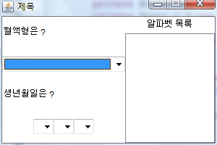
Java.awt Choice / List 클래스

Slide 32
Java.awt Choice / List 클래스
class Exam_07_Sub extends Frame{
  private Label blood_lb = new Label("혈액형은 ? ");
  private Choice blood_ch = new Choice();
  private Label birth_lb = new Label("생년월일은 ?");
  private Choice year_ch = new Choice();
  private Label year_lb = new Label("년 ");
  private Choice month_ch = new Choice();
  private Label month_lb = new Label("월 ");
  private Choice day_ch = new Choice();
  private Label day_lb = new Label("일 ");
  private Label alpha_lb = new Label("알파벳 목록", Label.CENTER);
  private List alpah_li = new List();

Slide 33
Java.awt Choice / List 클래스
  private BorderLayout bl = new BorderLayout();
  private Panel p = new Panel();
  private GridLayout gl = new GridLayout(4, 1);
  private Panel p1 = new Panel();
  private GridBagLayout gbl = new GridBagLayout();
  private Panel p2 = new Panel();
  private BorderLayout bl1 = new BorderLayout();
  public Exam_07_Sub(String title) {
    super(title);
    this.init();

Slide 34
Java.awt Choice / List 클래스
    super.setSize(300, 200);
    Dimension screen = Toolkit.getDefaultToolkit().getScreenSize();
    Dimension frm = super.getSize();
    int xpos = (int)(screen.getWidth() / 2 - frm.getWidth() / 2);
    int ypos = (int)(screen.getHeight() / 2 - frm.getHeight() / 2);
    super.setLocation(xpos, ypos);
    super.setResizable(false);
    super.setVisible(true);
  }

Slide 35
Java.awt Choice / List 클래스
  public void init() {
    this.setLayout(bl);
    p.setLayout(gl);
    p1.setLayout(gbl);
    p1.add(year_ch); p1.add(year_ch);
    p1.add(month_ch); p1.add(month_ch);
    p1.add(day_ch); p1.add(day_ch);
    p.add(blood_lb); p.add(blood_ch);
    p.add(birth_lb); p.add(p1);
    this.add("Center", p);
    p2.setLayout(bl1);
    p2.add("North", alpha_lb);
    p2.add("East", alpah_li);
    this.add("East", p2);
  }
}

Slide 36
Java.awt Choice / List 클래스
  public void init() {
      // Data Setting
      blood_ch.add("A형");
      blood_ch.add("B형");
      blood_ch.add("O형");
      blood_ch.add("AB형");
      for(int i = 2007; i >= 1900; --i) {
        year_ch.add(String.valueOf(i));
      }
      for(int i = 1; i <= 12; ++i) {
        month_ch.add(String.valueOf(i));
      }
      for(int i = 1; i <= 31; ++i) {
        day_ch.add(String.valueOf(i));
      }
      for(char i = 'A'; i <= 'Z'; ++i) {
        String s = "" + i + i + i;
        alpha_li.add(s);

Slide 37
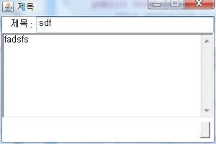
Java.awt.TextField & TextArea 클래스

Slide 38
Java.awt.TextField & TextArea 클래스
class Exam_08_Sub extends Frame{
  private Label title_lb = new Label("제목 : ", Label.RIGHT);
  private TextField title_tf = new TextField();
  private TextArea contents_ta = new TextArea();
  private Button register_bt = new Button();
  private BorderLayout bl = new BorderLayout();
  private Panel p = new Panel();
  private BorderLayout bl1 = new BorderLayout();
  private Panel p1 = new Panel();
  private FlowLayout fl = new FlowLayout(FlowLayout.RIGHT);

Slide 39
Java.awt.TextField & TextArea 클래스
  public Exam_08_Sub(String title) {
    super(title);
    this.init();
    super.setSize(300, 200);
    Dimension screen = Toolkit.getDefaultToolkit().getScreenSize();
    Dimension frm = super.getSize();
    int xpos = (int)(screen.getWidth() / 2 - frm.getWidth() / 2);
    int ypos = (int)(screen.getHeight() / 2 - frm.getHeight() / 2);
    super.setLocation(xpos, ypos);
    super.setResizable(false);
    super.setVisible(true);
  }

Slide 40
Java.awt.TextField & TextArea 클래스
  public void init() {
    this.setLayout(bl);
    p.setLayout(bl1);
    p.add("West", title_lb);
    p.add("Center", title_tf);
    this.add("North", p);
    this.add("Center", contents_ta);
    p1.setLayout(fl);
    p1.add(register_bt);
    this.add("South", p1);
  }
}

